Slide 1
Cancer ANALYSIS Relationship of Socioeconomic Factors and Health outcomes in US - 2015
Sana Ayubzai, Calogera McCormick, Dustn Reyna, Aaron Lileoien, Lenin Perez
20Apr2023

Slide 2
Table of contents
01:
Data Collection
02
Data cleaning
03:
Data Analysis & VisualizATION
04:
Key Takeaways,
Next Steps, Lessons LearnEd

Slide 3
Data COllection
recent data within 10 years
Interest in health & finance
Public Available DAtaset
Data citation: Health Outcomes and Socioeconomic Factors | Kaggle:
https://www.kaggle.com/datasets/thedevastator/uncovering-trends-in-health-outcomes-and-socioec?resource=download

Slide 4
Data Variables
Social
Financial
Age
Race
Marital status
Education
Employment status
Poverty status
Health insurance
Median income
Health
Community
Cancer incidence
Target incidence rate
Mortality rate
Population size (of town)
Research available close to you

Slide 5
TOOLS USED DATA ANALYSIS Internet search - Kaggle, CDC, cancer.gov, census datasets Jupyter notebook - 2 source csvs (social/health data, locations, >3000 counties) Pandas - Cleaning for missing values and illogical data (eg >100 yrs) Python - New csv with averages incidences per state (50 rows) Postgres - 2 csvs into SQL Sqlalchemy - Analysis goals Plotly health vs income relationship (line) Vscode cancer incidence vs location (scatterplot) Flask impact of social variables on cancer diagnosis (radar) Leaflet cancer incidence per location (map)

Slide 6
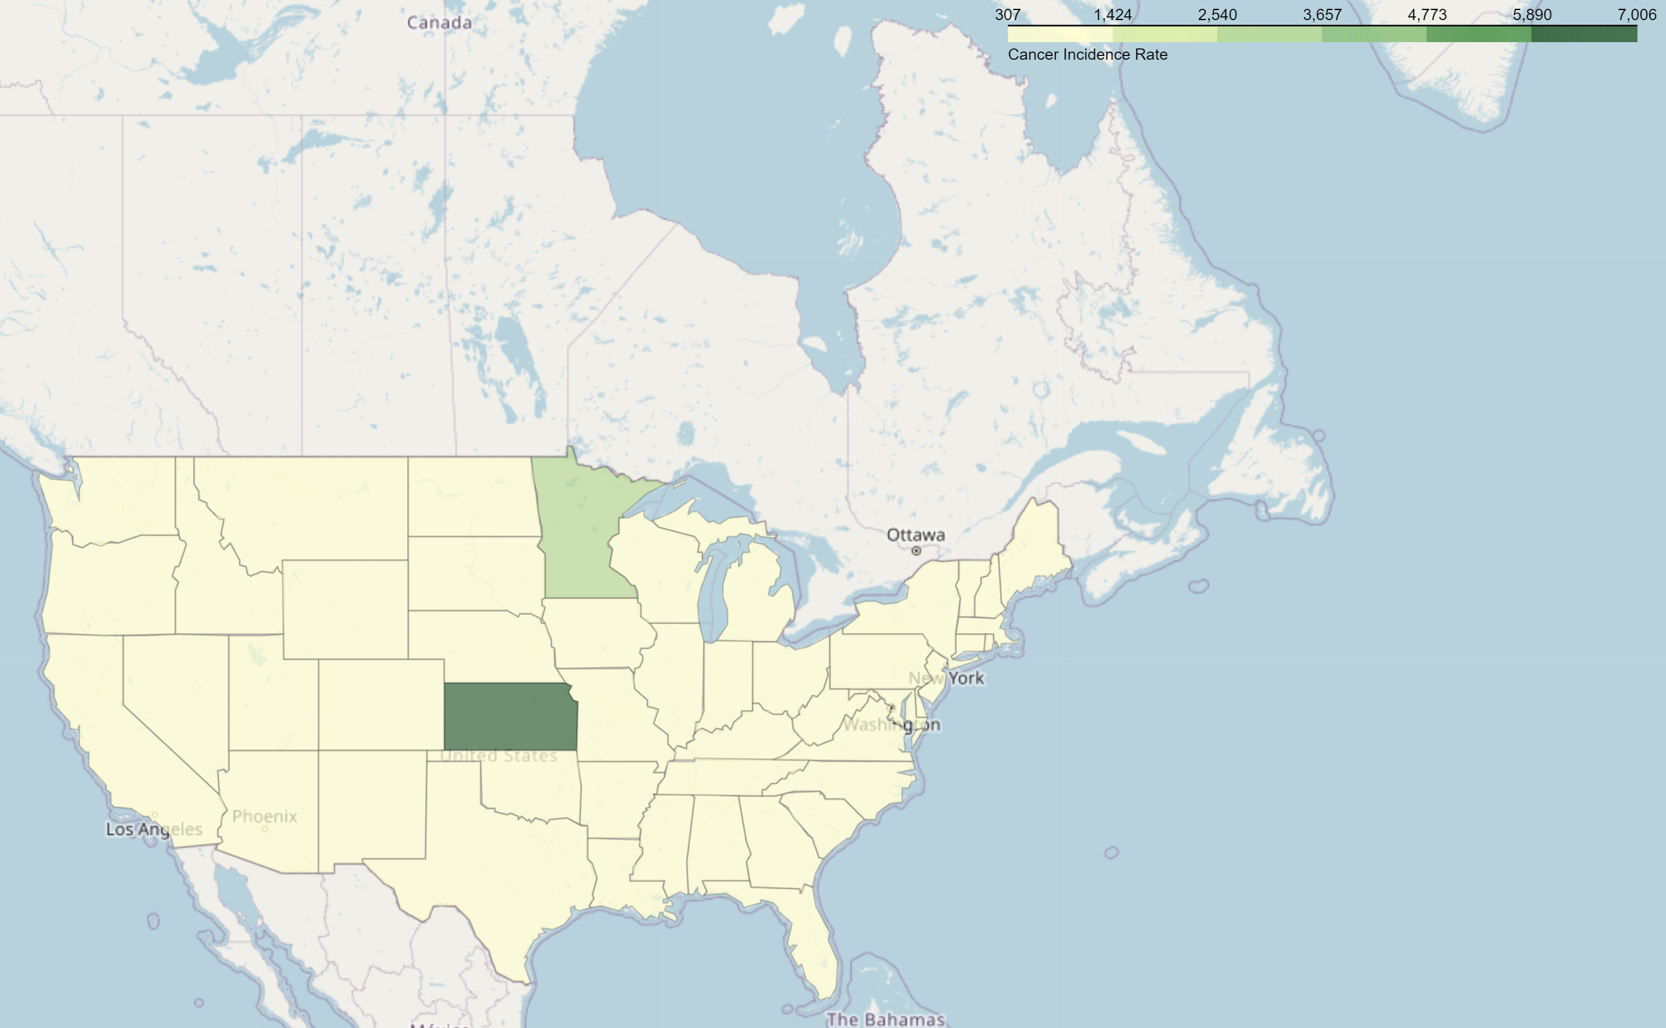
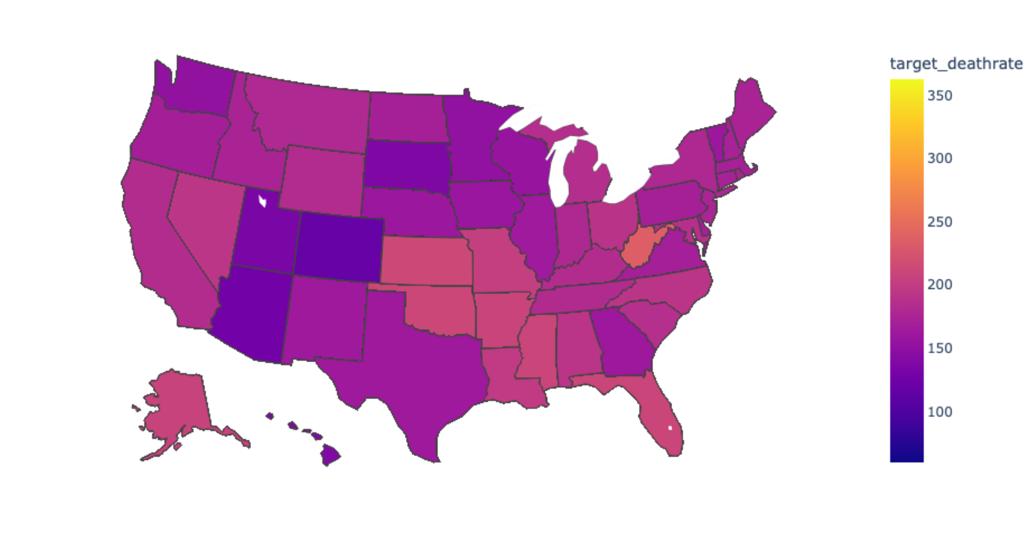
MAPPING CANCER IN US
* Live demo – Chart 2
Cancer incidence # of diagnoses
Note: outliers impact ability to see data at low incidences
Target death rate
as the CDC

Slide 7
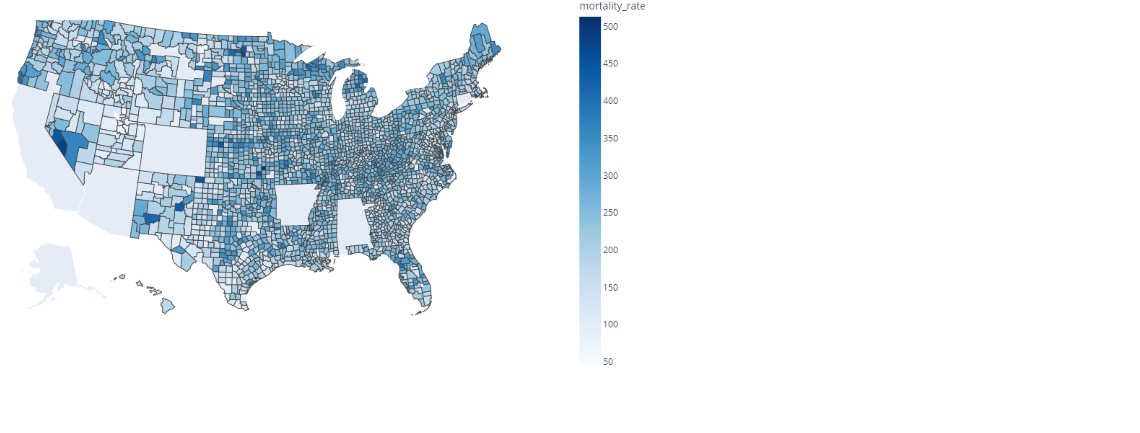
Mortality Rate (for any reason) per County

Slide 8
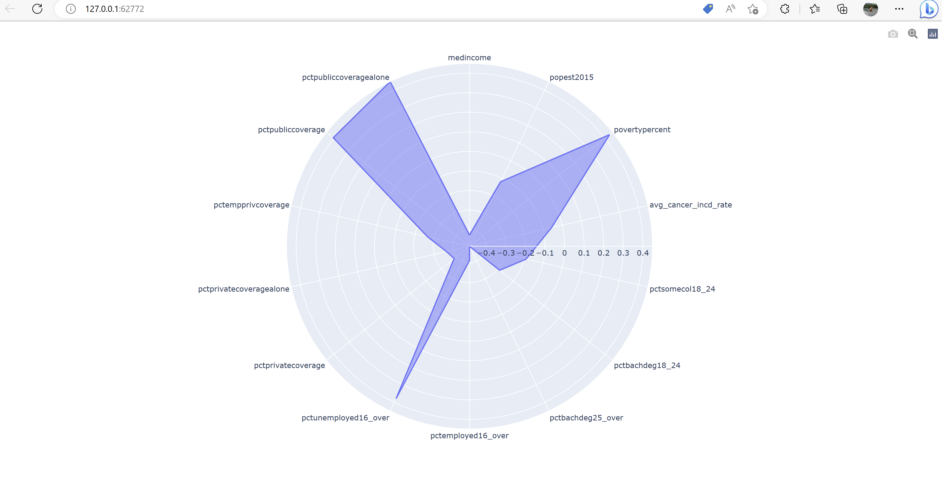
Social determinants of health
High correlation with cancer incidence - unemployment, poverty and insurance
* Live demo
Zoom button

Slide 9
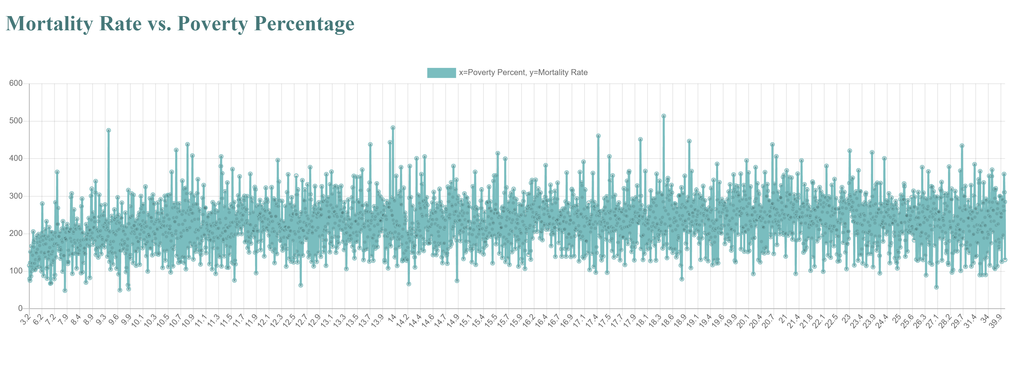
—SOMEONE FAMOUS
Mortality vs Poverty
* Live demo
No appreciable rise in death rate as poverty increases.
Why? What other variables can we add to investigate further (eg, marriage as support network? Public insurance availability as safety net?

Slide 10
Key Takeaways
Reduce scope of project
Understand code dictionary
Choose simpler visualizations to start with
Prepare graphs on individual pages.
Take care not to change code that works…
More complete data sets are from paid sources, don’t know how data set was partially cleaned or manipulated when pulling from Kaggle

Slide 11
Lessons Learned
Heat maps based on preset code easier than working with latitude and longitude
More time focused on simplifying and once we get something simple working then tackle more complex visuals
Test runs one little bit a time, harder to fix bugs on code for full graph
Run to see data from json, then test code for graph
Misjudged time needed to code graphs. Spent more time than needed on cleaning and grouping data (eg, making age ranges, income ranges).

Slide 12
NEXT STEPS
Compare relationshipS of more social determinants
Build interactive model
Education
insurance
MARRIAGE
Scatter-
plot all health

